Slide 1
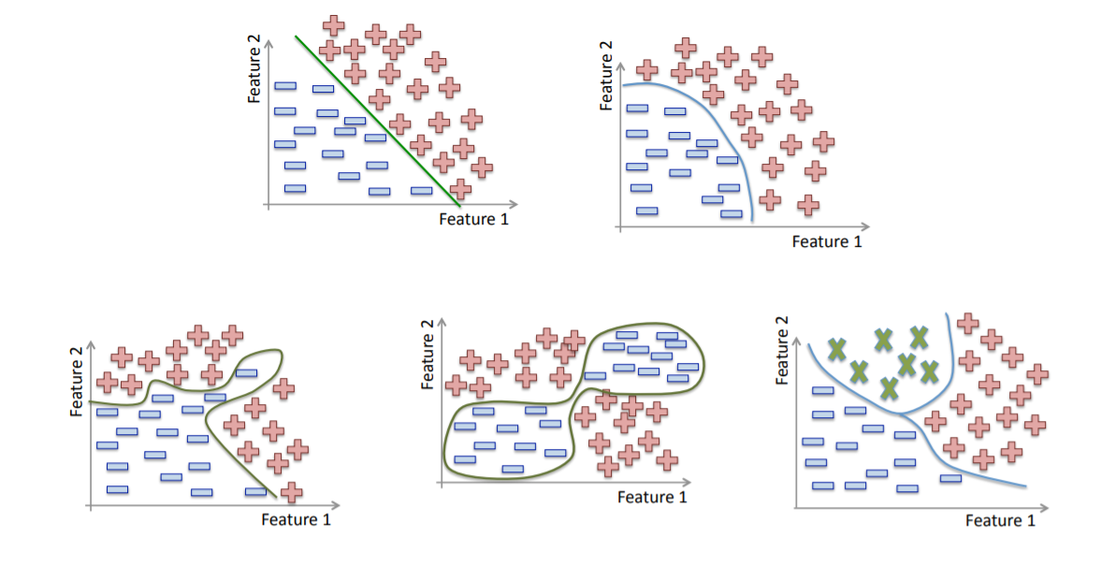
Classification Algorithms
Classification is a type of supervised learning problem that involves prediction of discrete outputs, this is often actualized using discriminative line or curves (also known as decision boundaries)
Logistic Regression
Support Vector Machines
Decision Tree
Ensemble Learning Techniques
Multi-Layer-Perceptron Classifier
K-Nearest Neighbour

Slide 2
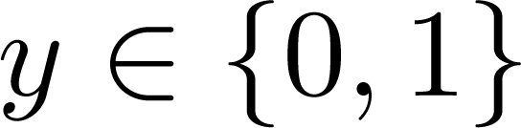
Classification
Email: Spam / Not Spam?
Online Transactions: Fraudulent (Yes / No)?
Tumor: Malignant / Benign ?
0: “Negative Class” (e.g., benign tumor)
1: “Positive Class” (e.g., malignant tumor)

Slide 3
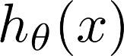
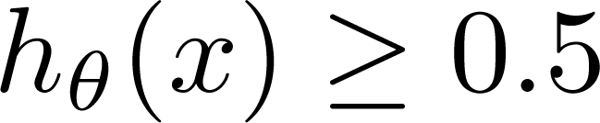
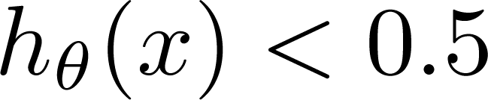
(Yes) 1
Malignant ?
(No) 0
Tumor Size
Tumor Size
Threshold classifier output at 0.5:
If , predict “y = 1”
If , predict “y = 0”

Slide 4
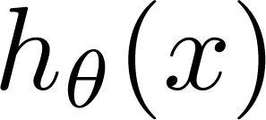
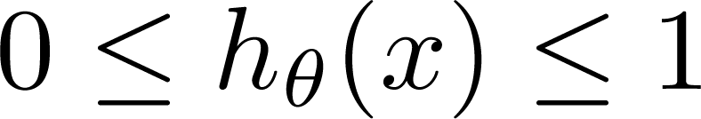
Classification: y = 0 or 1
can be > 1 or < 0
Logistic Regression:

Slide 5

Hypothesis Representation
Logistic
Regression

Slide 6
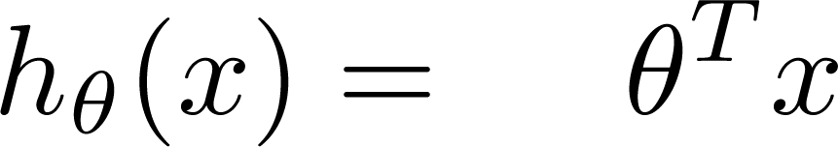
Logistic Regression Model
Want
1
0.5
Sigmoid function
Logistic function
0

Slide 7
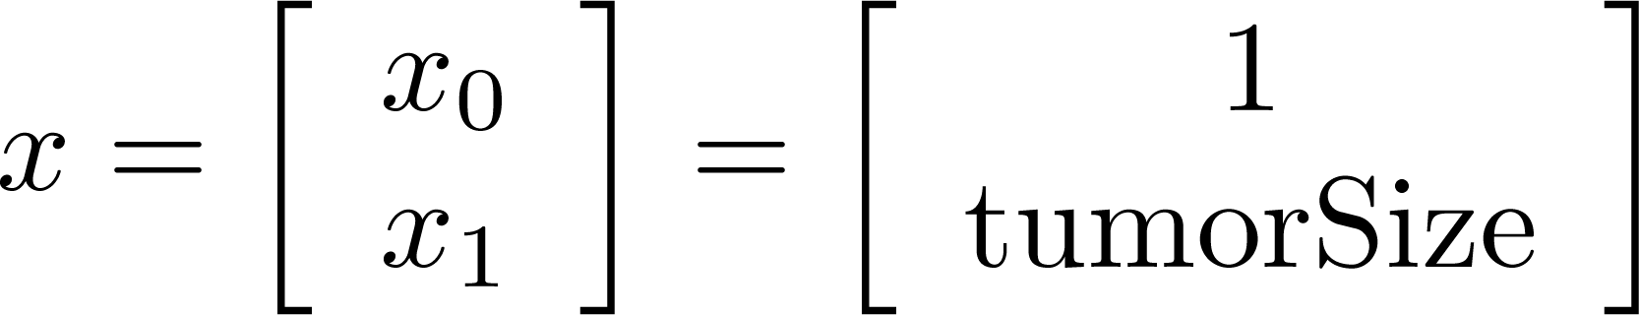
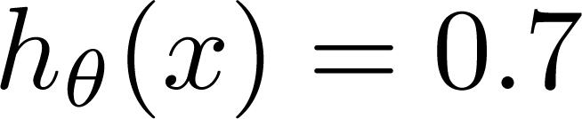
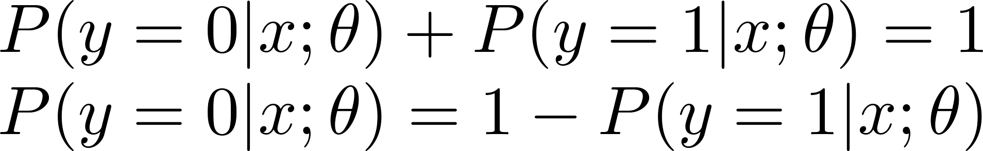
Interpretation of Hypothesis Output
= estimated probability that y = 1 on input x
Example: If
Tell patient that 70% chance of tumor being malignant
“probability that y = 1, given x,
parameterized by ”

Slide 8
Decision boundary
Logistic
Regression

Slide 9
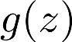
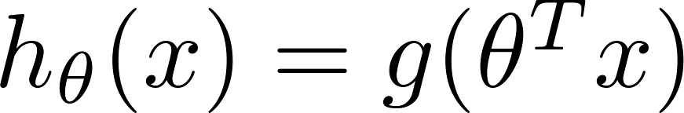
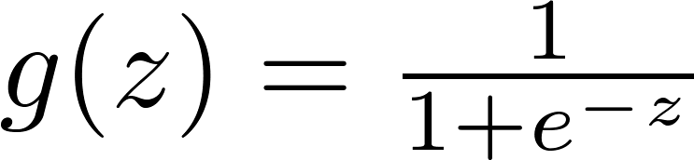
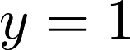
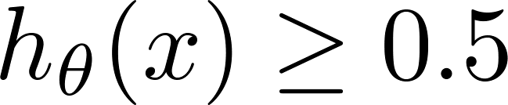
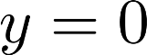
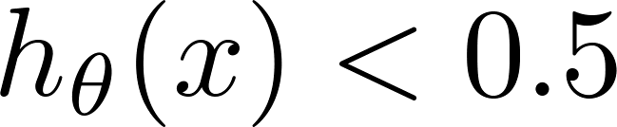
Logistic regression
1
z
Suppose predict “ “ if
predict “ “ if

Slide 10
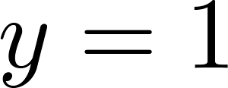
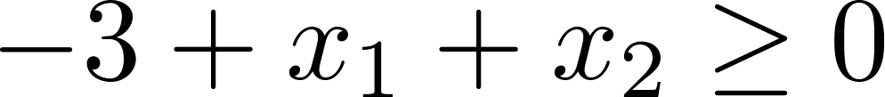
How to fit (find) Parameter θ Parameter θ (θ0, θ1, θ2) defines the decision boundary not the training set. Training set may be used to find the Parameter θ
Decision Boundary
x₂
3
2
1
1
2
3
x₁
Predict “ “ if

Slide 11
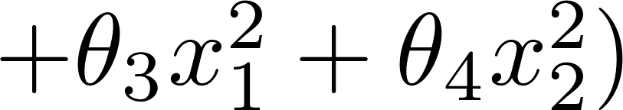
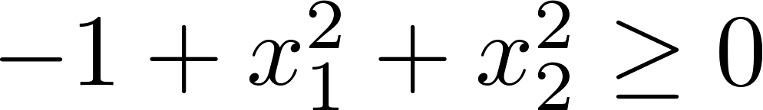
Non-linear decision boundaries
x₂
1
x₁
-1
1
-1
Predict “ “ if
x₂
x₁

Slide 12
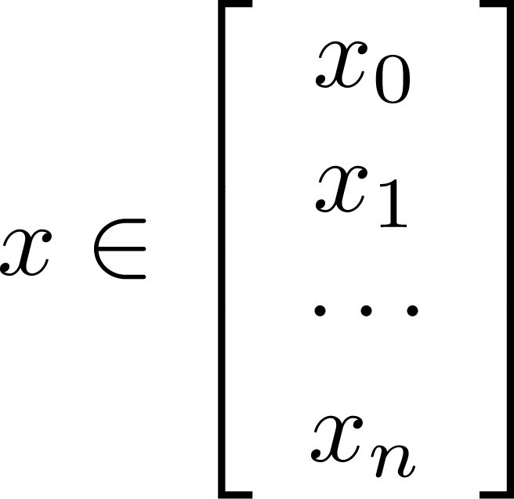
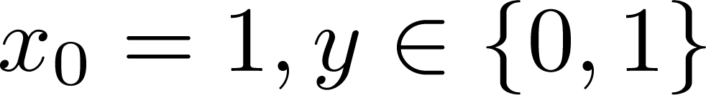
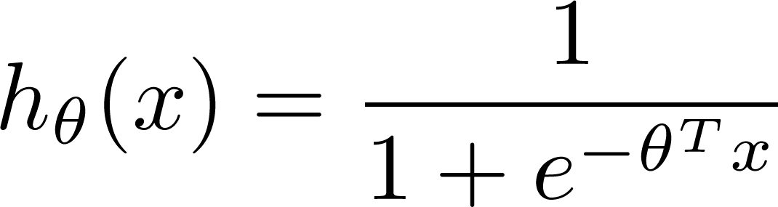

Training set:
m examples
How to choose parameters ?

Slide 13
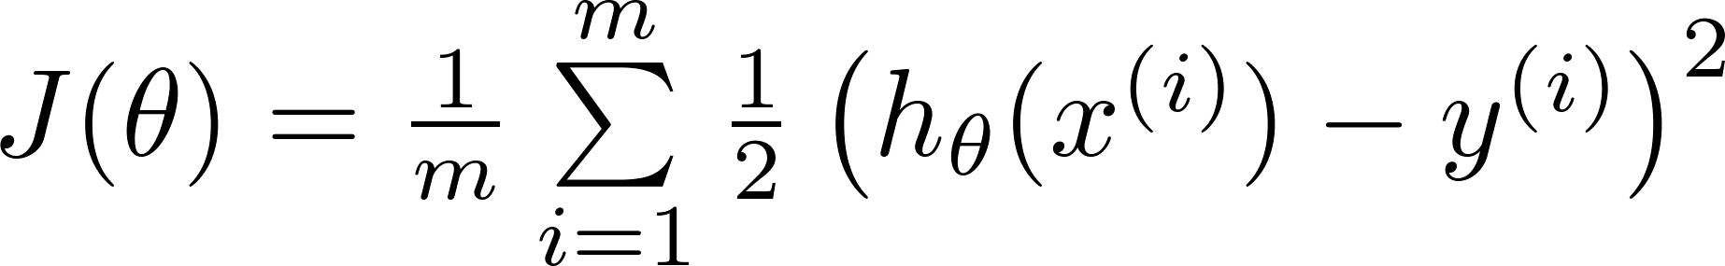

J(θ) is non-linear beacause of the
presence of non-linear sigmoid function
Cost function
Linear regression:
Non-Linear
Function
“non-convex”
“convex”
We want J(θ) to
behave like this

Slide 14
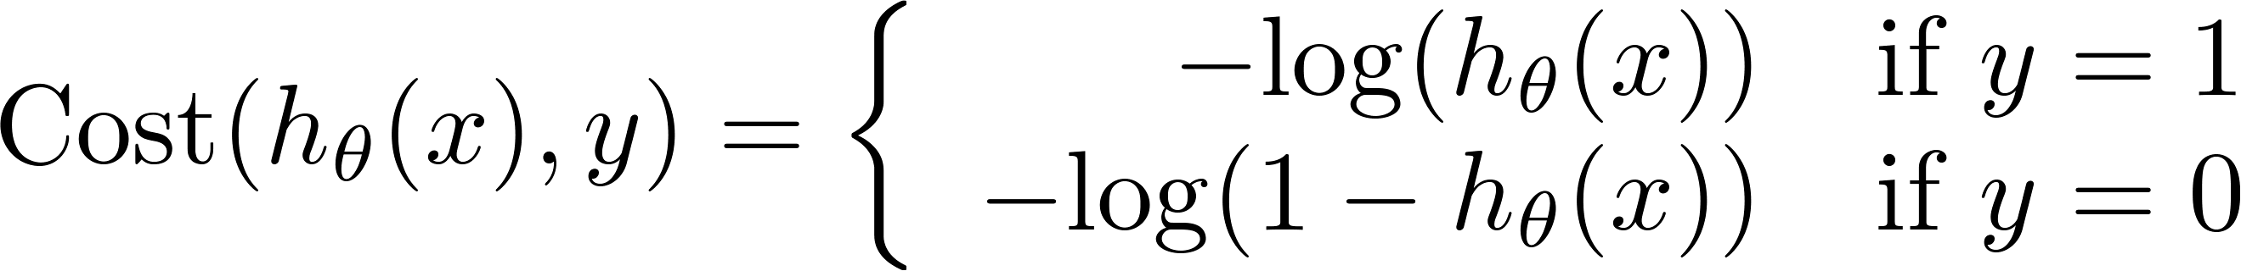
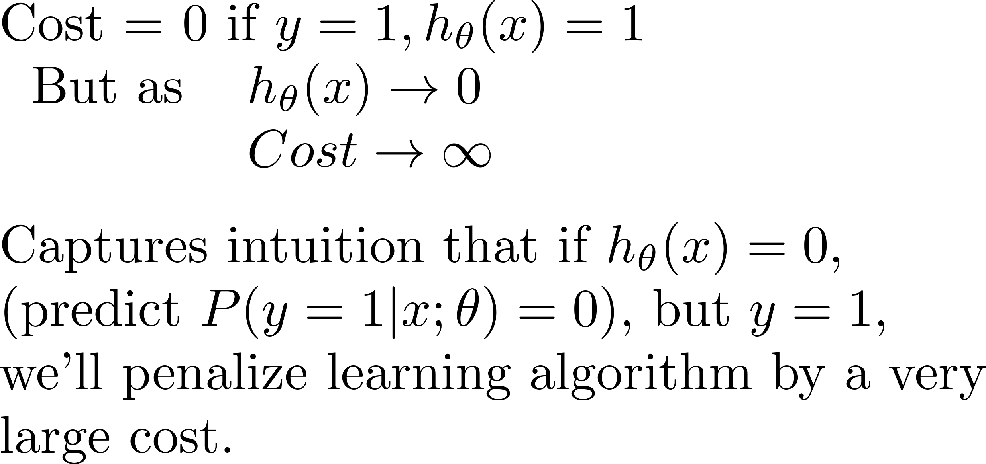
Logistic regression cost function
Different
Cost Function
If y = 1
0
1

Slide 15
Logistic regression cost function
If y = 0
0
1

Slide 16
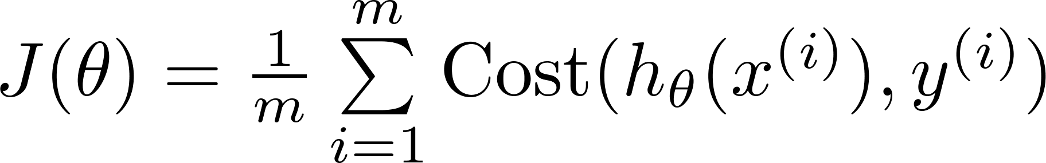
Logistic regression cost function

Slide 17

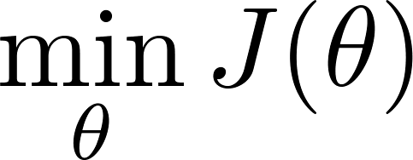

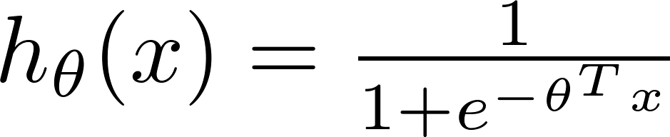
Logistic regression cost function
To fit parameters :
To make a prediction given new :
Output

Slide 18


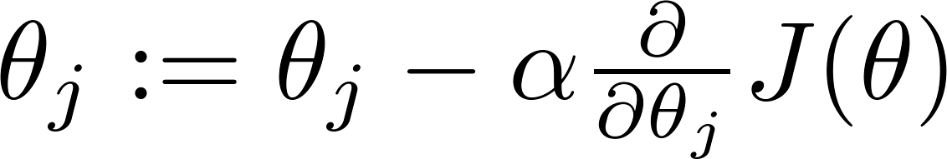
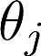

Gradient Descent
Want :
Repeat
(simultaneously update all )

Slide 19
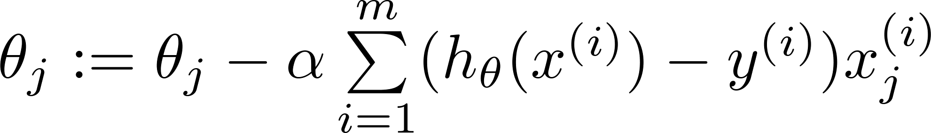
Gradient Descent
Want :
Repeat
(simultaneously update all )
Algorithm looks identical to linear regression!

Slide 20

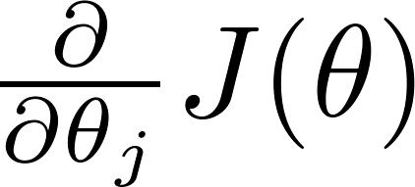
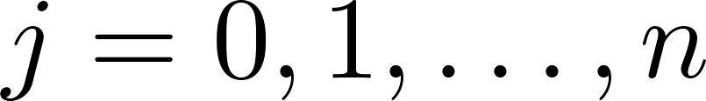
Optimization algorithm
Cost function . Want .
Given , we have code that can compute
(for )
Gradient descent:
Repeat

Slide 21

Optimization algorithm
Given , we have code that can compute
(for )
Optimization algorithms:
Gradient descent
Advantages:
No need to manually pick
Often faster than gradient descent.
Disadvantages:
More complex
Conjugate gradient
Broyden–Fletcher–Goldfarb–Shanno
(BFGS)
Limited Memory
-BFGS (L-BFGS)

Slide 22
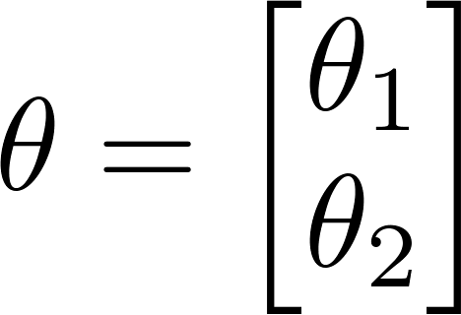
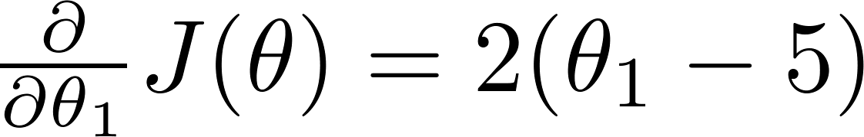

Example:
function [jVal, gradient] = costFunction(theta)
jVal = (theta(1)-5)^2 + ... (theta(2)-5)^2;
gradient = zeros(2,1);
gradient(1) = 2*(theta(1)-5); gradient(2) = 2*(theta(2)-5);
options = optimset(‘GradObj’, ‘on’, ‘MaxIter’, ‘100’);
initialTheta = zeros(2,1); [optTheta, functionVal, exitFlag] ...
= fminunc(@costFunction, initialTheta, options);

Slide 23

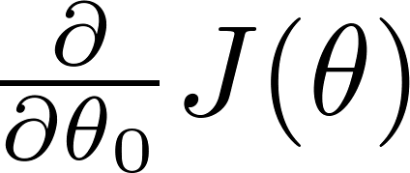
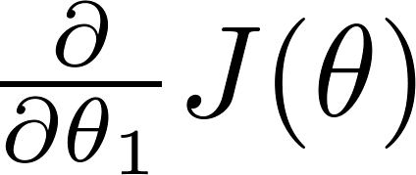
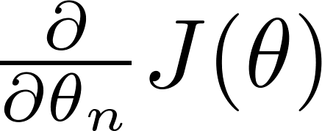
theta =
function [jVal, gradient] = costFunction(theta)
code to compute
jVal = [ ];
code to compute
gradient(1) = [ ];
code to compute
gradient(2) = [ ];
code to compute
gradient(n+1) = [ ];

Slide 24
Multiclass classification
Email foldering/tagging: Work, Friends, Family, Hobby
Medical diagrams: Not ill, Cold, Flu
Weather: Sunny, Cloudy, Rain, Snow

Slide 25
Binary classification:
Multi-class classification:
x₂
x₂
x₁
x₁

Slide 26
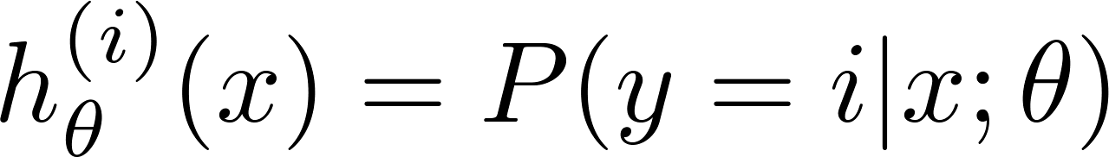
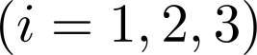
x₂
One-vs-all (one-vs-rest):
x₁
x₂
x₂
x₁
x₁
x₂
Class 1:
Class 2:
Class 3:
x₁

Slide 27
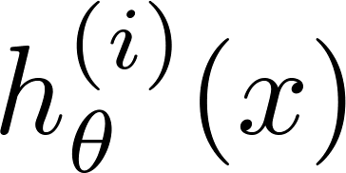

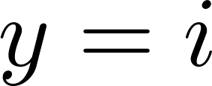
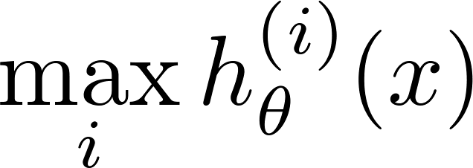
One-vs-all
Train a logistic regression classifier for each class to predict the probability that .
On a new input , to make a prediction, pick the class that maximizes

Slide 28
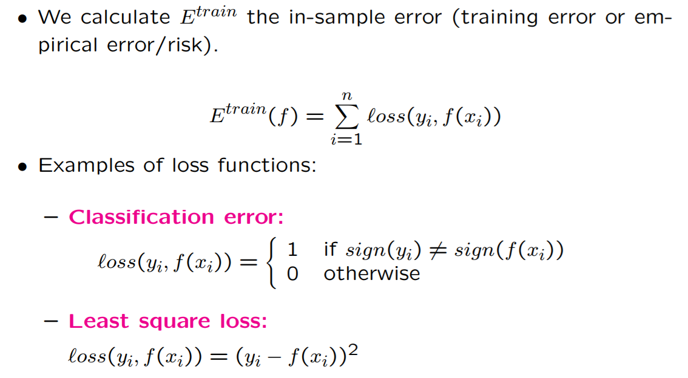
Classification Empirical Error

Slide 29
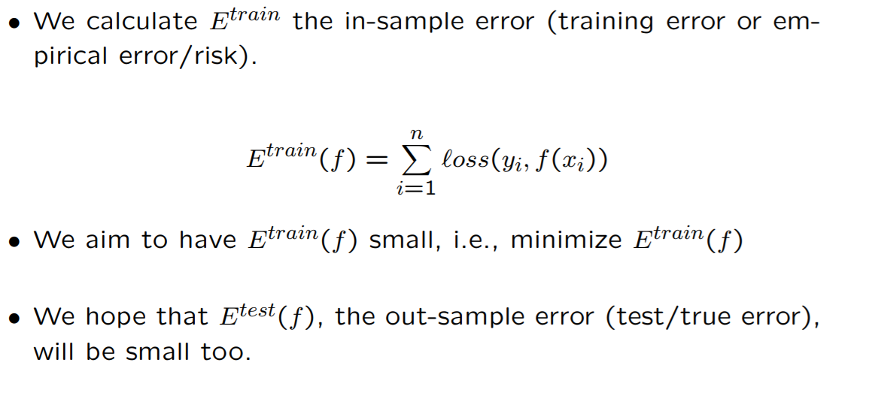
Classification Empirical Error

Slide 30

Overfitting & Underfitting

Slide 31
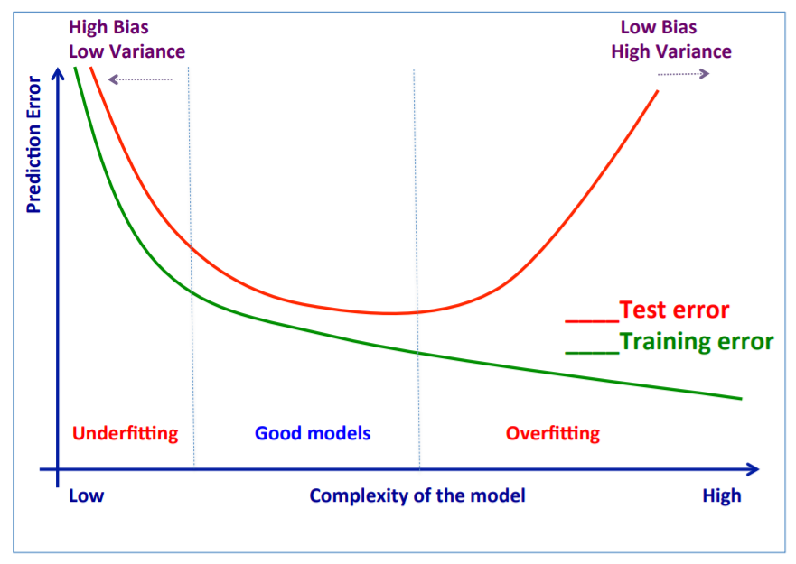
Structural Risk Minimization

Slide 32
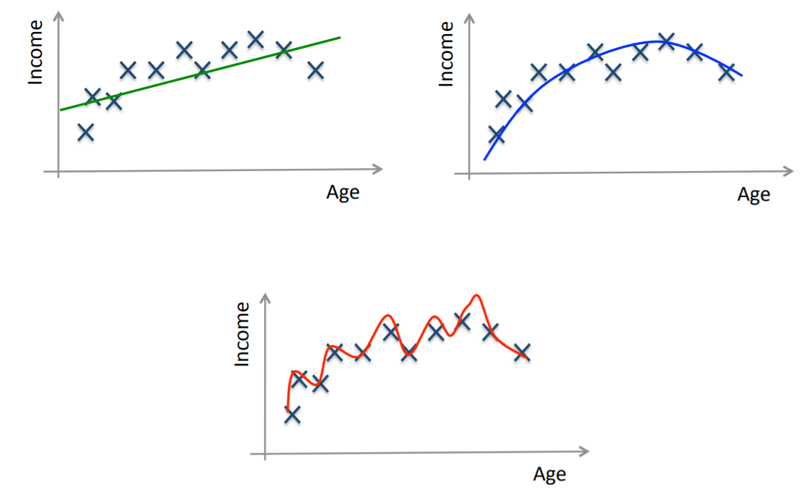
Training and Testing

Slide 33

Training and Testing

Slide 34

Training and Testing

Slide 35

Training and Testing

Slide 36

Bias-Variance Trade-off

Slide 37


Bias-Variance Trade-off
Increasing bias (not always) reduces variance and vice-versa
Error = bias^2 + variance +irreducible error
The best model is where the error is reduced.

Slide 38
Training and Testing a Model
In general, use simple models!
Reduce the number of features manually or do feature selection.
Do a model selection.
Use regularization (keep the features but reduce their importance by setting small parameter values).
Do a cross-validation to estimate the test error.

Slide 39


Regularization: Intuition

Slide 40

Types of Regularization

Slide 41

Types of Regularization

Slide 42

Regularization: Intuition

Slide 43
Train, Validation and Test
Training set is a set of examples used for learning a model (e.g., a classification model).
Validation set is a set of examples that cannot be used for learning the model but can help tune model parameters (e.g., selecting K in K-NN). Validation helps control overfitting.
Test set is used to assess the performance of the final model and provide an estimation of the test error. Note: Never use the test set in any way

Slide 44


K-fold Cross Validation

Slide 45

Classification Evaluation Metrics
Confusion Matrix

Slide 46

Classification Evaluation Metrics

Slide 47

Summary

